Slide 1
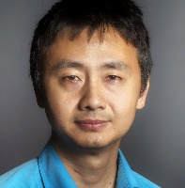
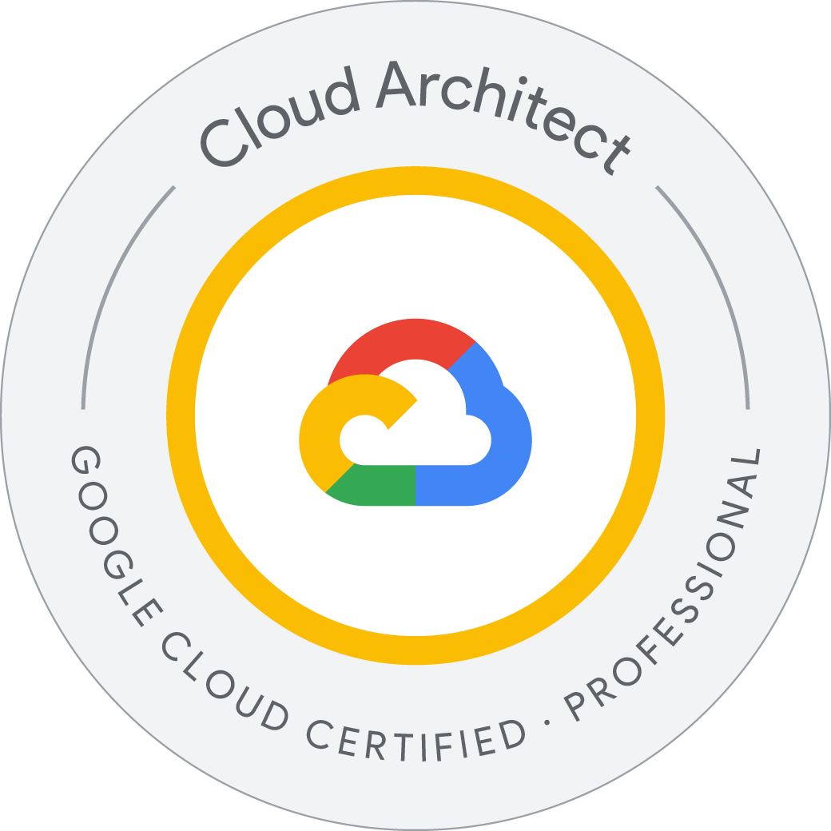

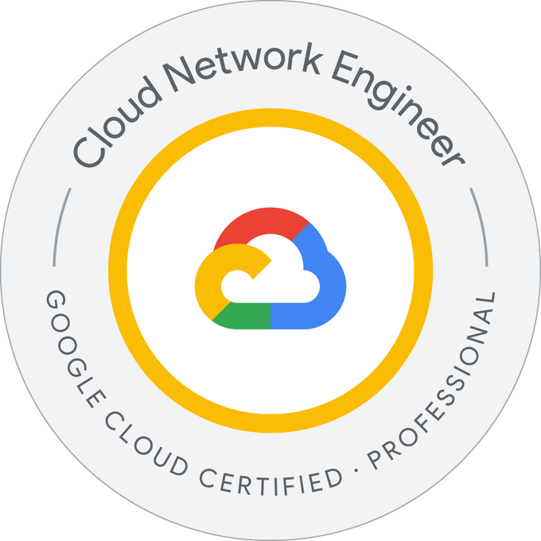


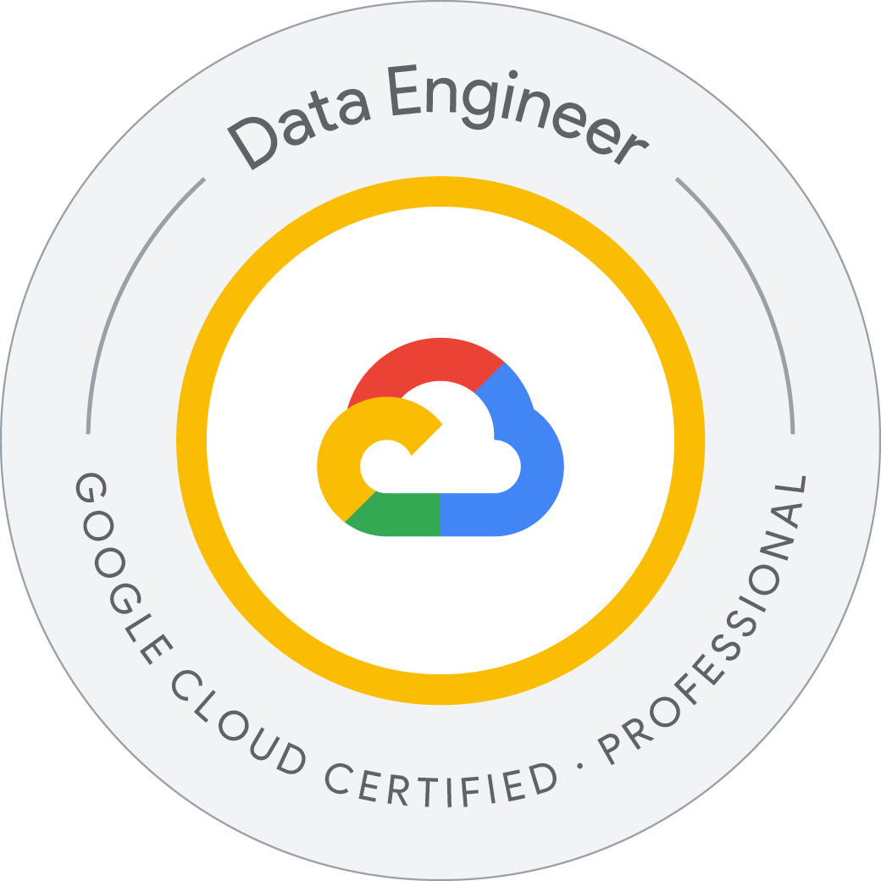
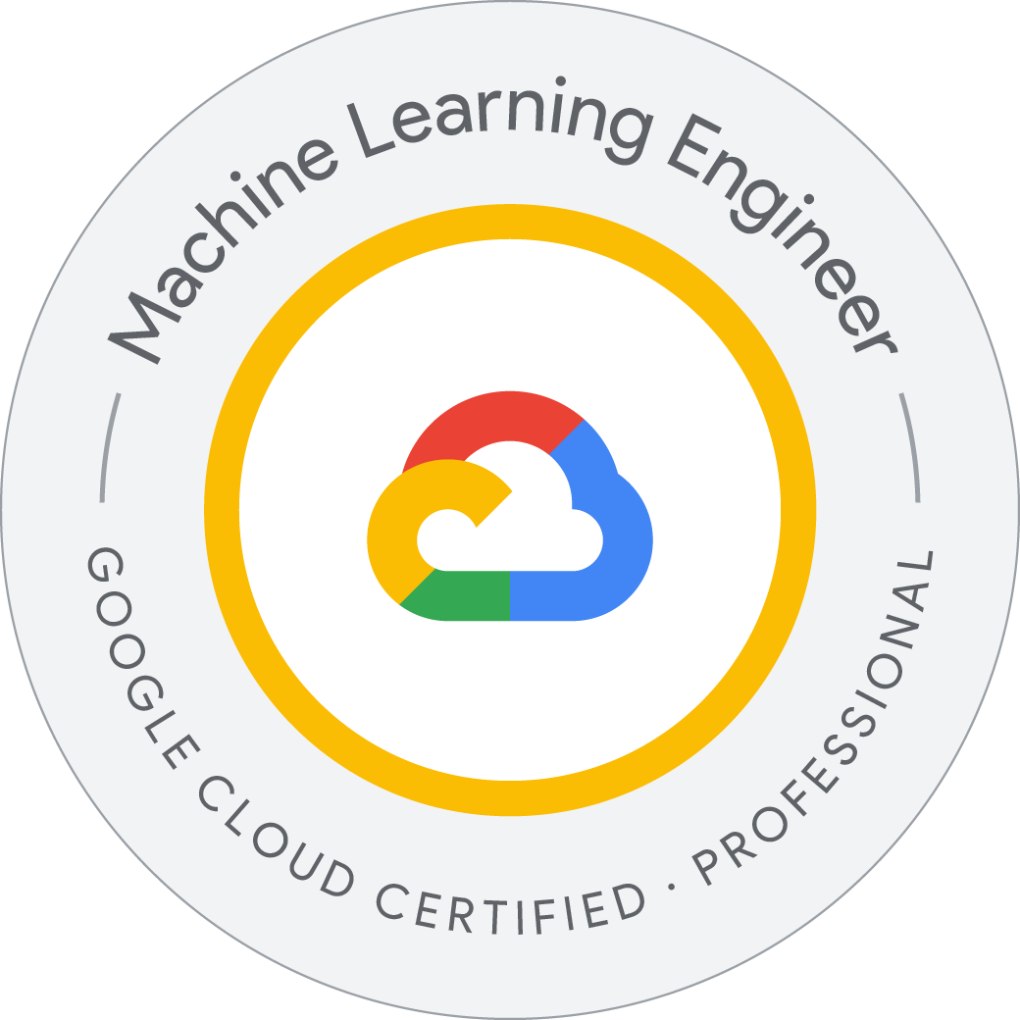
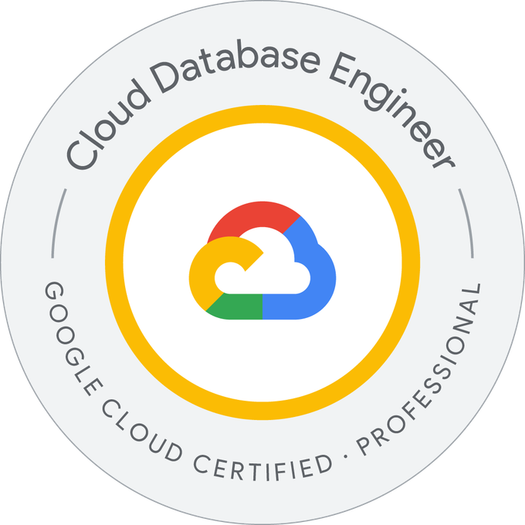
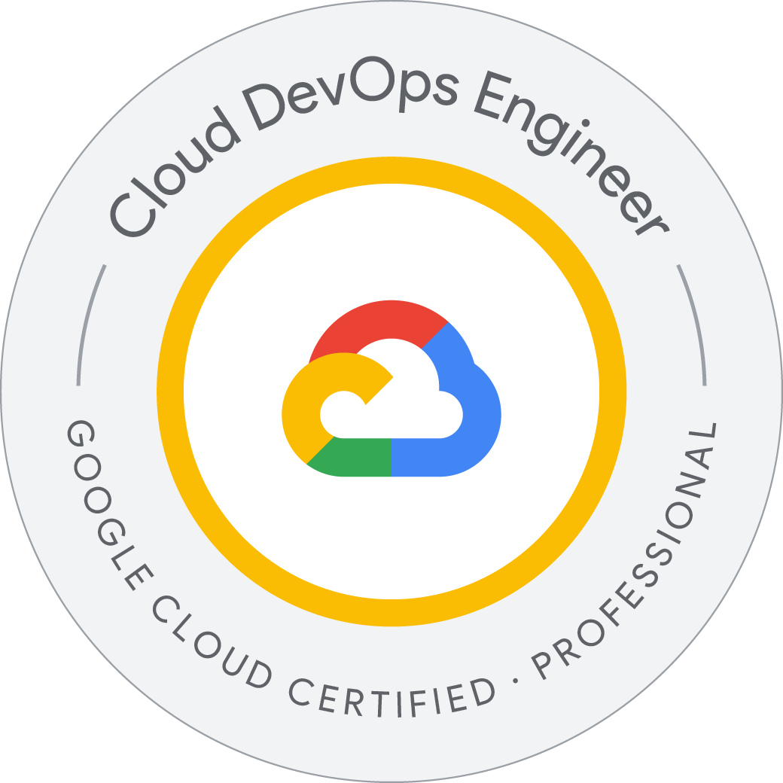
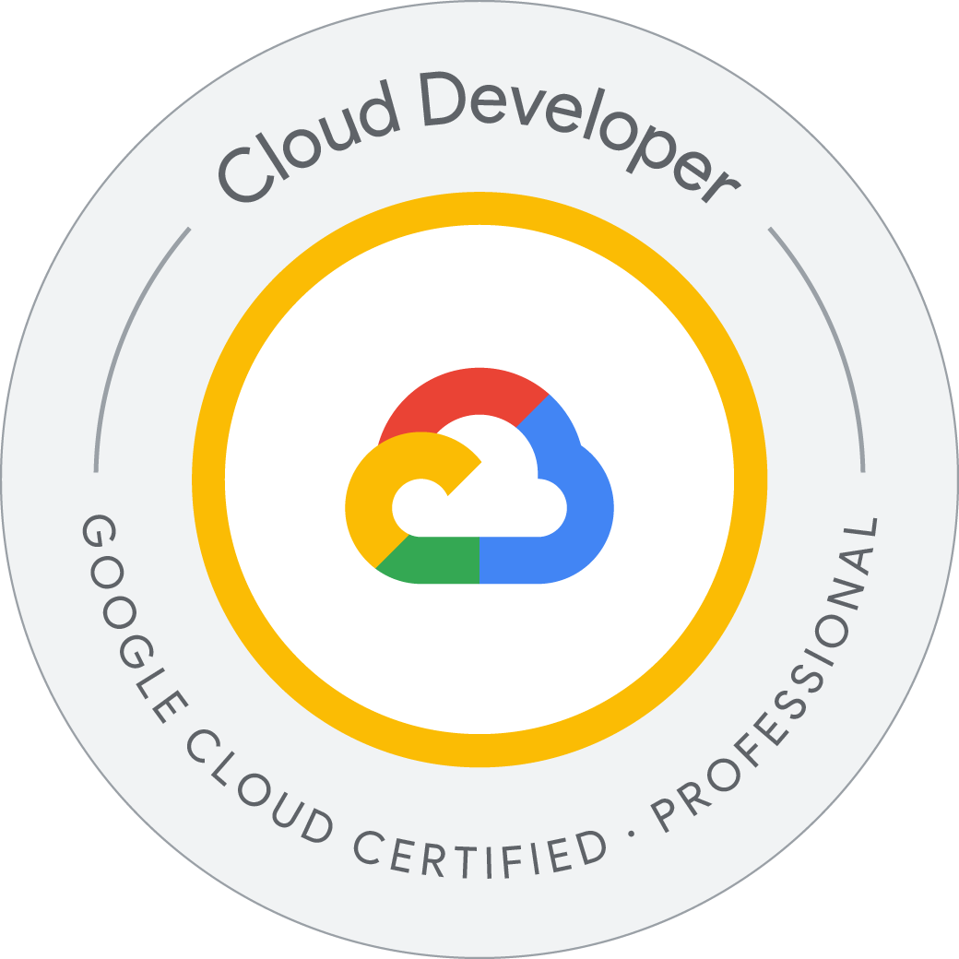
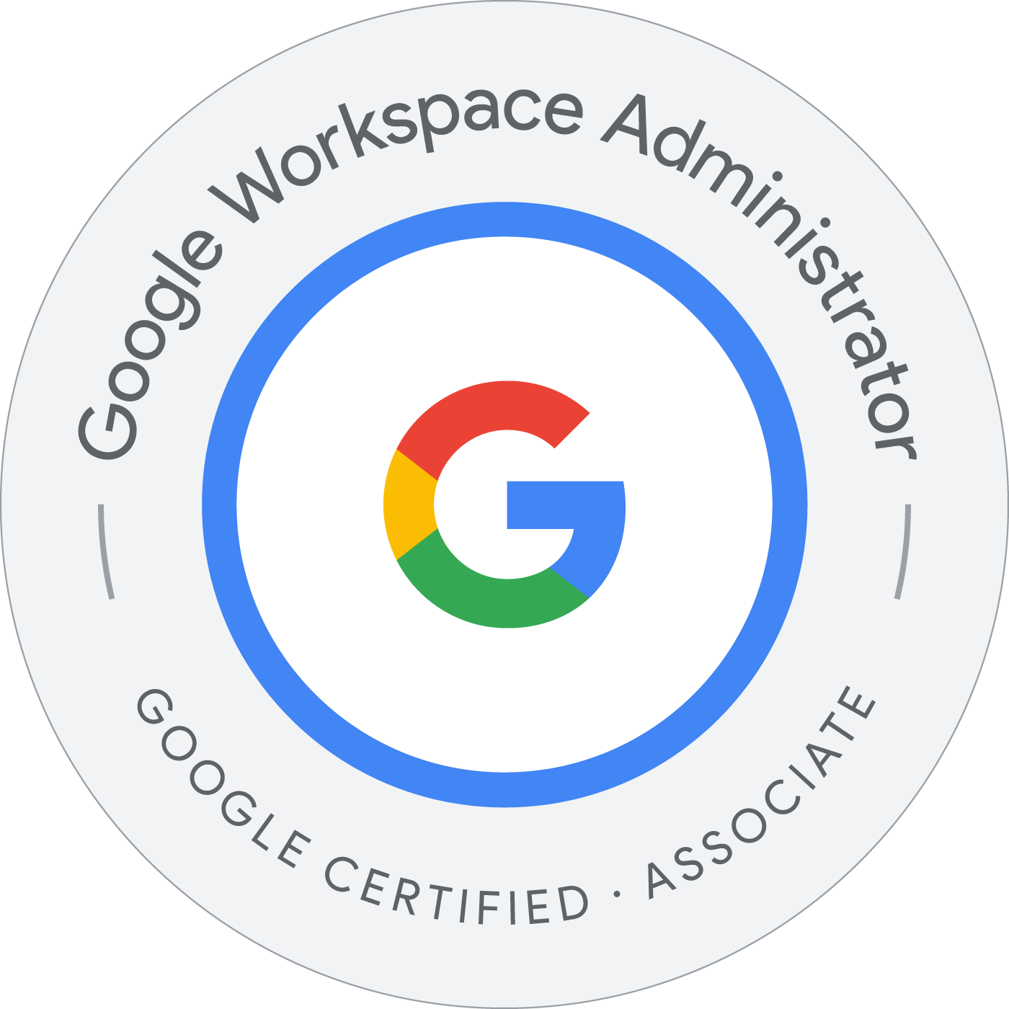
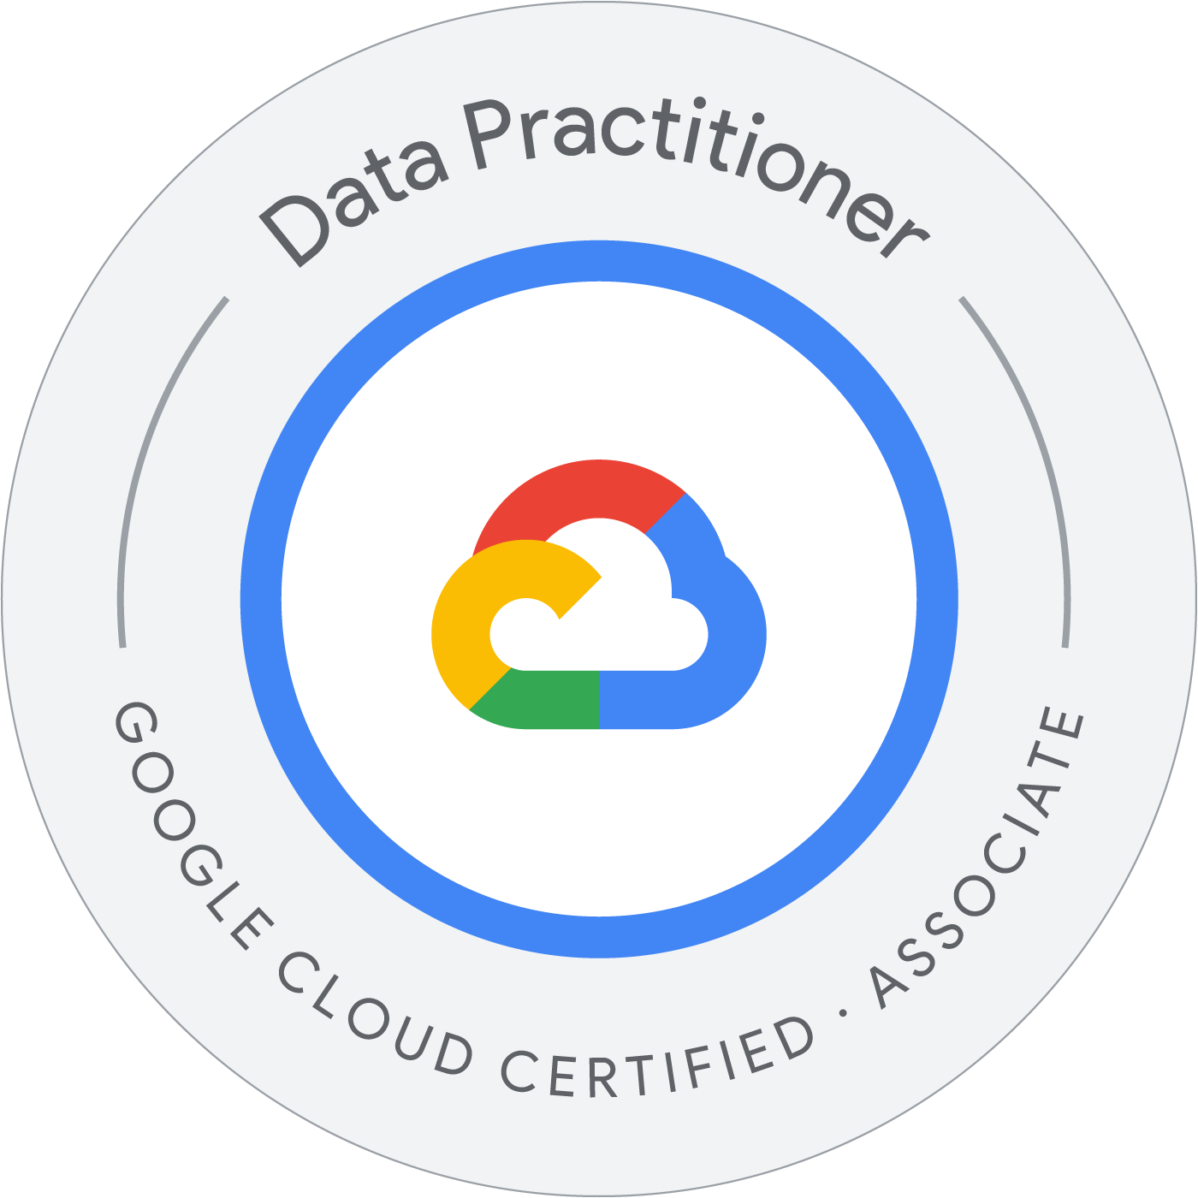
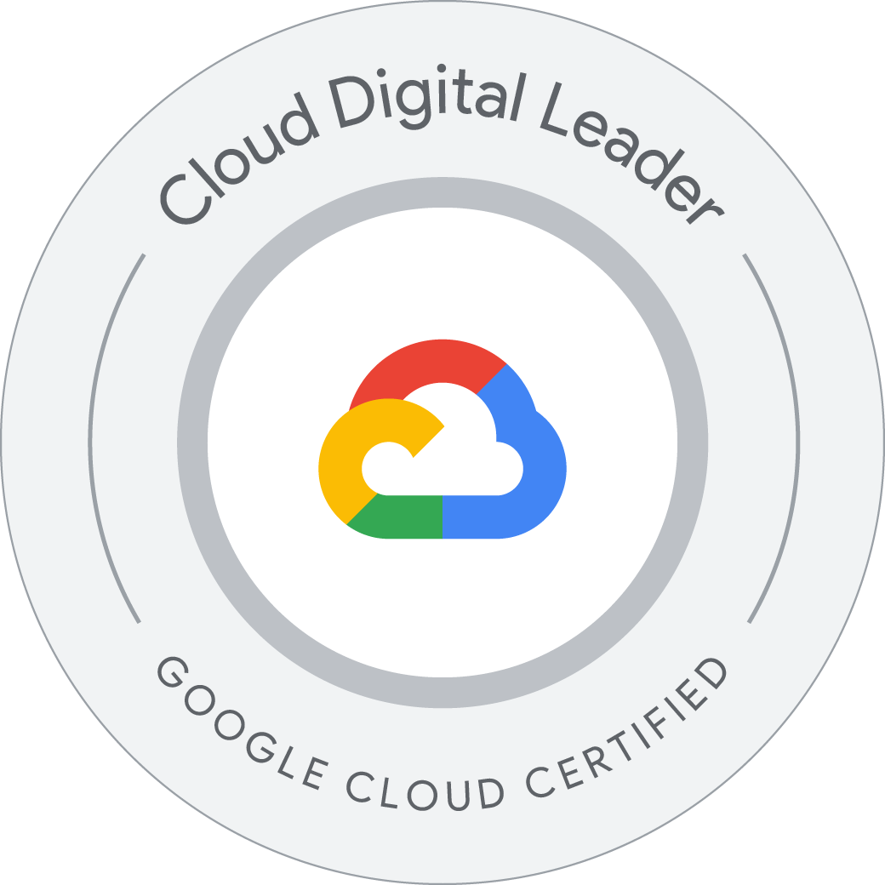
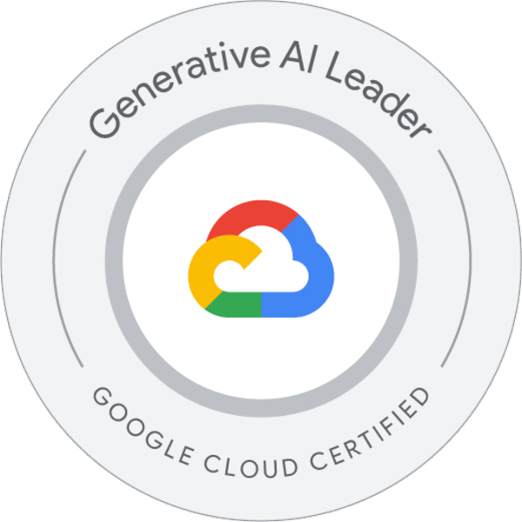
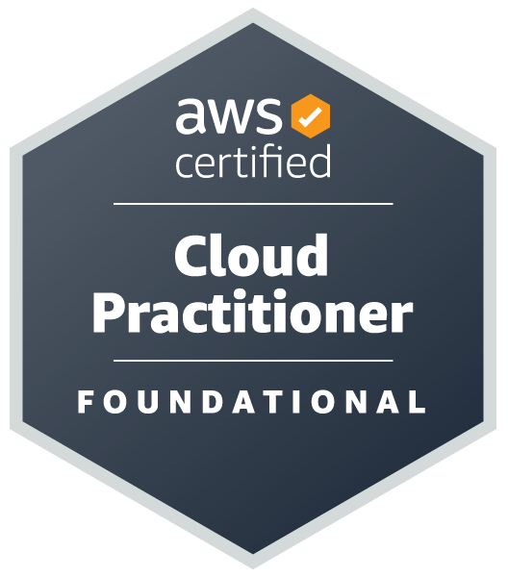

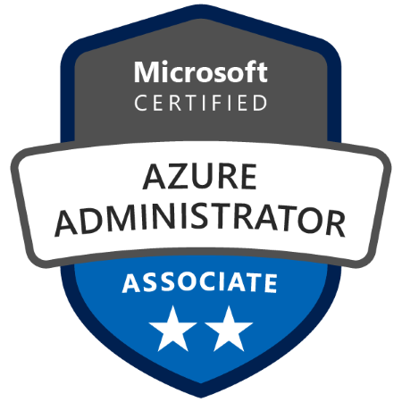
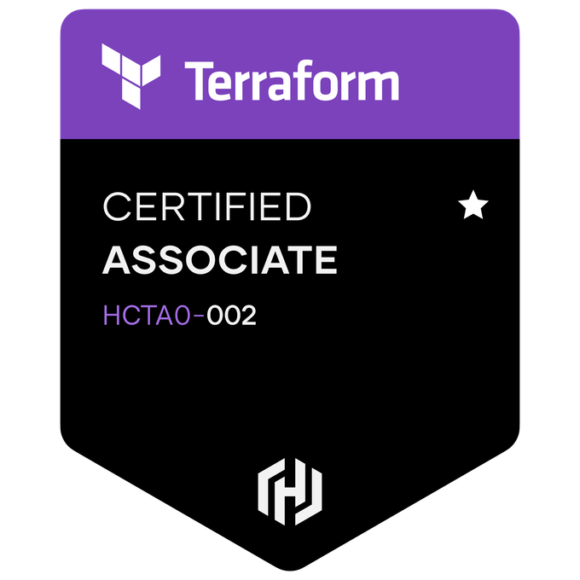
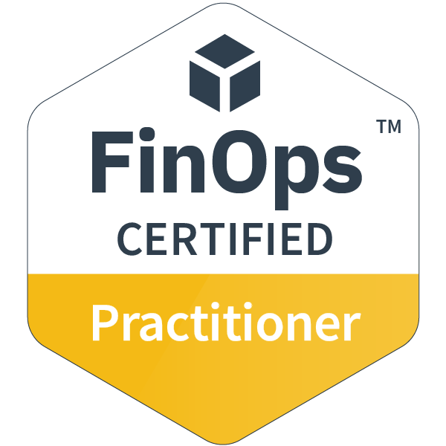
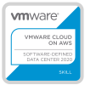

Lin Zhu
Email: lin.c.zhu@accenture.com
Denver, CO, United States
Lin is a veteran hands-on Cloud Architect Lead focusing on hybrid multi cloud such as GCP, AWS, Azure and on-prem DC, with deep technology stack skills encompassing all areas of datacenter and cloud technologies including server, storage, network, security, virtualization, backup/DR and IaC/Terraform/Ansible cloud automation.
For the past 30+ years, Lin has taken roles such as cloud solution architect, engineer, project manager and delivery lead on Data Management, Application/Workload/Data Cloud Migration, MLOps, GenAI, Infrastructure Build-out projects, in vendors, telecom service providers and consulting firms.
Lin is a certified PMP and ITIL foundation v3 since 2009 along with many industry certificates earned from multiple leading vendors.
Global Asset Management Firm - AWS Cloud Architect and DevOps lead for Agentic AI
Architect and implement the infrastructure supports Gen AI in AWS and setup the CI/CD pipeline
Solution including 7 marketing agents with LangChain/LangGraph architecture deployed to EKS, RDS/Aurora, KMS, IAM, Kong and Apache
Global Food Distributor - GCP Cloud Architect, Data Engineering lead for Data Warehouse/Lake
Architect and implement the infrastructure supports Data ingestion from various data source including SFDC, SAP, AS/400 etc.
Manage onshore/offshore team for multiple workstreams
National Healthcare provider - GCP Cloud Architect, Cloud Native Application migration lead
Architect and lead the application migration from Tanzu Application Services to GCP Cloud Native services e.g. GKE and Cloud Run
National Telco - GCP Cloud Architect for Gen AI
Architect and implement the infrastructure supports Gen AI in GCP Vertex AI and setup the CI/CD pipeline
Solution include enabling IAP on Cloud Run services running on docker images with Python code to provide Gen AI agent function
Design Gen AI solution for scalability
Global Entertainment and Media corporation - GCP Cloud Architect
Architect and implement the foundation / landing zone / IAM / security for GCP to enable app migration to follow
Design multi cloud networking and workload distributing among GCP, AWS and Azure
National insurance company - GCP Gen AI consultant
Advice the AIML / Gen AI adoption team of engineers on Prompt Engineering, RAG, Model tuning strategy and techniques
Global Banking – Cloud Landing Zone, BigData foundation, Terraform automation, App migration
Built general landing zone as well as the foundation for BigData solutions in cloud
Multi continent regions landing zone with data sovereignty requirements
Advanced, robust IaC (Terraform) cloud automation with Chef, Ansible, Packer automation, coaching on teams’ performance
Global Telco and CSP – Cloud Ops Model, DevOps Pipeline on Test Automation and MLOps
Ensured efficient and toil-free Cloud Operation following Cloud Migration
Architected end-to-end Performance, Security, Chaos Engineering CI/CD and MLOps pipeline
Provincial Government Agency - Cloud Architect and Cloud Native Application Enablement
Advised Dev + Ops team on best practices for deploying web-based applications onto a highly secured, zero-trust networking cloud landing zone leveraging Cloud Native technologies
Define standards and processes for leveraging cloud-native technologies
Fed Government Agencies - Cloud Architect, Migration Project Manager and Microservices Ops
Advised hybrid multi cloud architecture strategy and workload disposition decision making process as well as migration methodology for mission critical applications
Discovered sophisticated applications dependency mapping to enable migration wave planning
Led cloud migration waves with well managed stakeholder communication
Production readiness for critical Cloud Native event driven microservices application rollout
Transformed the backup solution into hybrid cloud model with substantially lower cost
Global manufacturer - Disaster Recovery Team Lead
Led Disaster Recovery Enablement and Implementation project
Design Disaster Recovery approaches involving multiple database technologies
Led the offshore resource team to implement Disaster Recovery and develop DR drill plan / SOP
Ran client onsite workshop on Disaster Recovery operations
National Retail Chain – Infrastructure Architect
Designed private cloud solution on contact center and VoIP application based on Cisco UCS, Nexus, EMC, NetApp & VMware
Designed shared network infrastructure among multiple workloads silos to reduce cost
Cloud Infra onboarding / Operation
Cloud Native App onboarding / Migration
Project Management: Project Planning, Scope, Schedule, Execution, Closing, People/Resource, Risk Management
Client Relationship Management, Vendor, Stakeholder Management
Sales, Technical Sales
GCP, Azure, AWS, Ali Cloud
Kubernetes, Kubernetes Enterprise, Edge
Terraform, Vault, Sentinel, Packer, Ansible, Chef, Jinja2
DevOps, SRE, Jenkins, GitLab, GitHub
DC, Server, Storage, NW/WiFi, Bkup & DR
Gen AI / OpenAI / Claude Code / Gemini Ent
Golang
Communications, Media & Technology
Banking, Financial, Securities, Insurance
Public Services – Fed & Local government
Consumer Goods & Services
Travel and Hospitality
Retail and Wholesale
K12 and Higher Education
GCP Certified Architect, Cloud, Network, Security, Data, GenAI/ML, DB, DevOps, SecOps, SRE, Workspace Eng, Developer
Azure Certified Solution Architect / Admin
AWS Certified Cloud Practitioner
Terraform, CloudScape Certified
ServiceNow Sys Admin and ITSM impl.
FinOps, PMP, ITIL v3 Foundation certified
B.S. degree in ECE from HUST

